Slide 1
Warm-UP
On your warm-up sheet for Goal Two, answer the following questions in complete sentences.
What is one right that you think everyone is guaranteed just by being a human being?
How good of a job do you think the U.S. government does at protecting that right?
Explain your answer.

Slide 2
Events Leading to War

Slide 3
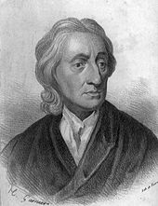
Publishing of Two Treatises of Government
Written by John Locke- 1689
Argues that the legitimacy of a government comes from the CONSENT OF THE PEOPLE BEING GOVERNED, otherwise known as the Social Contract Theory
People agree to give up their rights in exchange for protection from the government

Slide 4
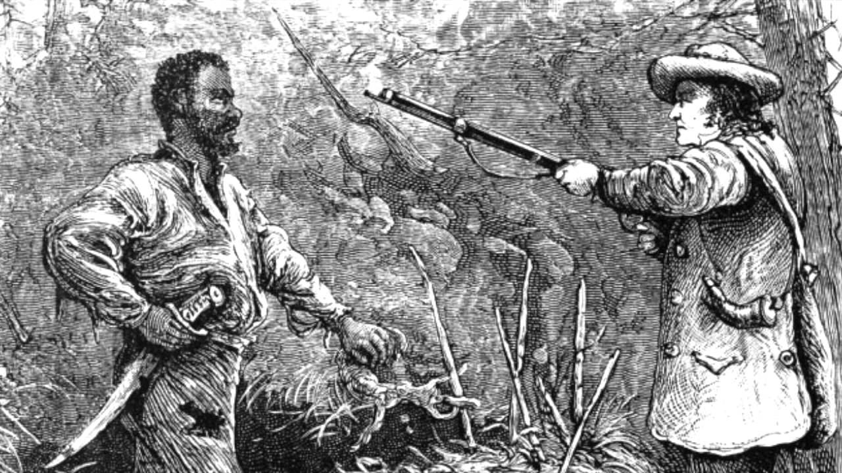
Stono Rebellion
September 1739: slaves in South Carolina revolt in an attempt to make it to Spanish Florida
Killed numerous slave-owning families
White militias met the rebels and fighting began…many slaves died and the rest were later executed
Led to harsher slave laws
Shows the growing dependence of southern colonies on slaves

Slide 5
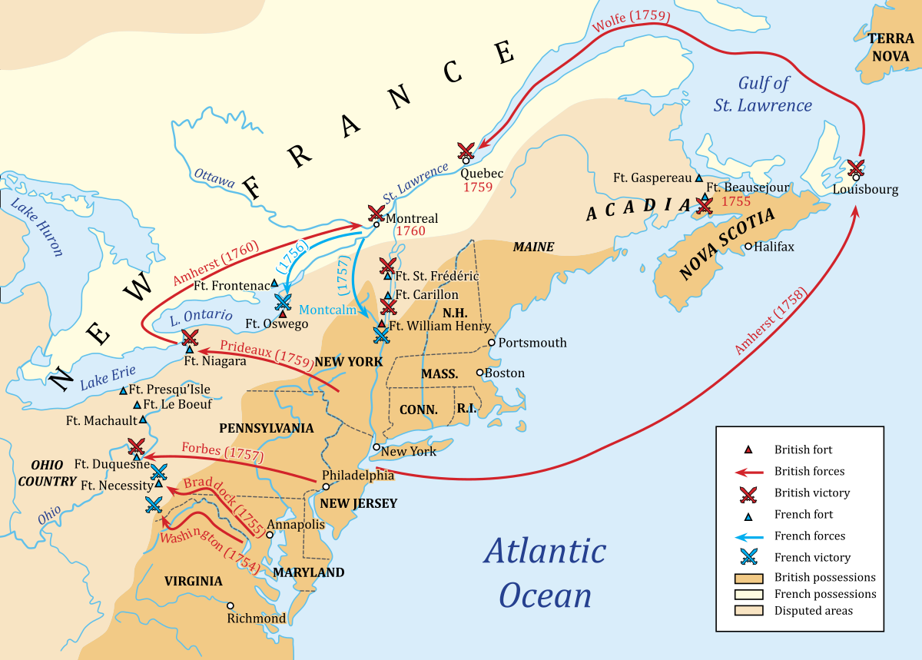
French and Indian War
Years: 1754-1763
Part of the larger conflict in Europe known as the Seven Years War
Started in the Ohio River Valley when French built Fort Duquesne- first attack led by George Washington
Everything changed with William Pitt
Got the Iroquois and Prussians on the side of the British
Victory for British official with the Treaty of Paris, 1763…British got all land east of the Mississippi River
Cost of war=taxes…leading to WAR WITH BRITAIN

Slide 6
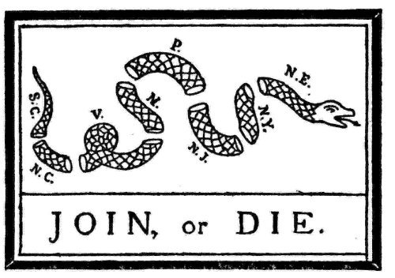
Albany Plan of Union
Proposed by Benjamin Franklin
First attempt to unite the colonies- Franklin modeled it after the Iroquois League
Colonies rejected the idea…but it will form the basis for the later Stamp Act Congress, Committees of Correspondence, and the Continental Congresses

Slide 7
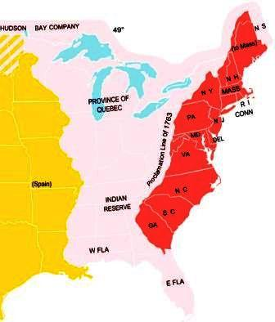
Proclamation of 1763
The Native Americans did not sign the Treaty of Paris
So- led by Ottawa Chief Pontiac, they attacked 8 British forts in the Ohio River Valley
British defeat the Native Americans by infecting them with small pox
To avoid future conflicts, they pass the Proclamation of 1763
Promise no settlement west of the Appalachian Mountains
Really angers southern colonists

Slide 8
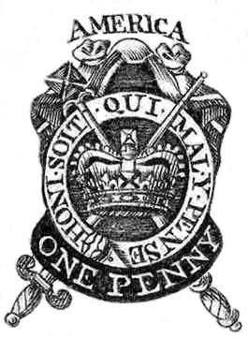
Stamp Act
1765
As a result of the costs of both the French and Indian War and the Seven Year’s War, Britain raises taxes throughout its empire, including the colonies
Required a stamp to be put on all British documents
Colonists claimed the act to be unconstitutional
Led to the formation of the Sons of Liberty and the Stamp Act Congress
Also made Ben Franklin fight for representation in Parliament

Slide 9
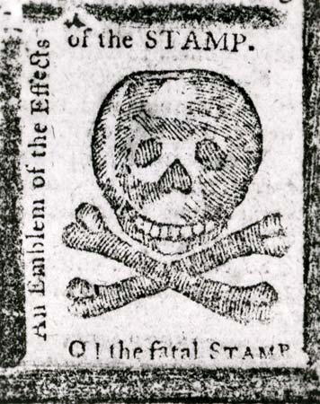
Stamp Act Congress
1765
Issued a “Declaration of Rights and Grievances” stating that Congress lacked the power to impose taxes on the colonists since they were not represented in Parliament
Colonies agreed to boycott British goods together until the Stamp Act was repealed
It worked- the Stamp Act is repealed in March 1766 due to pressure from British merchants on Parliament
In response, British Parliament issued the Declaratory Act claiming that they can make whatever laws they choose

Slide 10
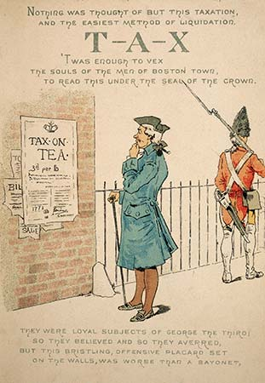
Townshend Acts
1766
Came a year after the repeal of the Stamp Act
It put taxes on glass, lead, tea, paint, and paper
Caused outrage amongst the colonies, still believing these laws were unconstitutional
Samuel Adams and Mercy Otis Warren called for boycotts within the Sons of Liberty and Daughters of Liberty
Things intensified when John Hancock’s boat, Liberty, was seized by British customs officers

Slide 11
Boston Massacre
March 5th, 1770
One big area of conflict was the competition for jobs between stationed British soldiers and colonists
An armed conflict ensued, leaving 5 colonists dead, including Crispus Attucks, the first to die in the conflict
Samuel Adams and other Patriots label this the “Boston Massacre”
As a result, Britain repeals the Townshend Acts

Slide 12
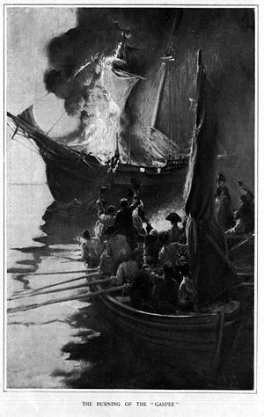
Gaspee Incident
1772
HMS Gaspee was in the Newport, Rhode Island harbor monitoring the colonies in an attempt to enforce the Navigation Acts
A group of colonists attacked the ship after it ran aground in shallow water
This was the first act of violence against the British
When Britain announced that those involved would face a trial in Britain, the colonists were outraged and formed the Committees of Correspondence

Slide 13
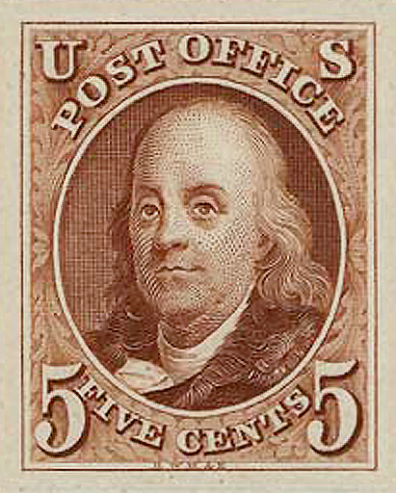
Committees of Correspondence
Proposed by the House of Burgesses in Virginia
Came about after the British announced the colonists were going to be taken overseas to be tried by juries in Britain after the Gaspee Incident
By 1774, almost all colonies were connected
First time the colonies were united in any real way
Helped spread information about what was happening in all colonies- leading to a growth in the Patriot movement

