Slide 1
Warm-UP
On your warm-up sheet for Goal Two, answer the following questions in complete sentences.
Judging by what you remember from earlier knowledge, describe in 4-5 sentences why the colonists finally decided to break free from Great Britain. Things to consider:
Big events leading up to the declaration
Specific philosophies or beliefs
Key individuals

Slide 2
Events Leading to War

Slide 3
Bringing Back of the Tea Act
1773
Purpose: to save the struggling British East India Company- which were hurt by colonial boycotts
Law granted the company the right to sell tea to the colonies free of taxes that colonial sellers had to pay
Cut the colonial sellers out of the tea business

Slide 4
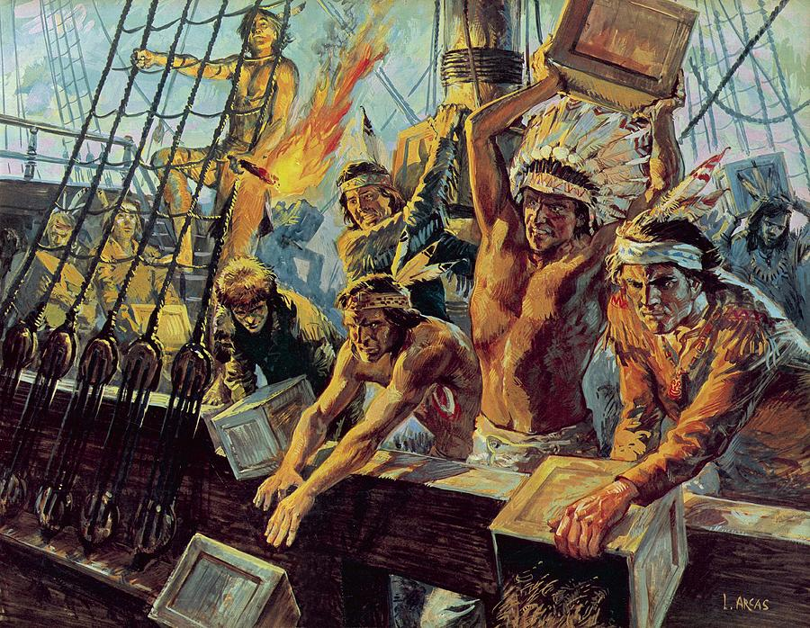
Boston Tea Party
December 16th, 1773
Led by the Sons of Liberty in Boston
Protestors dressed as Native Americans ran aboard three British ships in Boston harbor and dumped 18,000 pounds of tea in the water
Britain responded with:
Intolerable Acts
Forbidding any trade in New England ports until the colonists paid for the tea that was ruined.

Slide 5
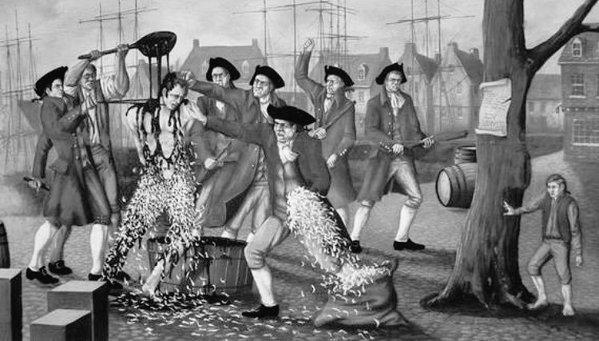
Intolerable Acts
1774
Called the “Coercive Acts” by Parliament
Meant to serve as a punishment for the Boston Tea Party
Associated laws:
Boston Port Act: shut down the harbor
Quartering Act
Martial Law in Boston
Administration of Justice Act: trials in Great Britain instead of colonies
In response, the colonies called the 1st Continental Congress

Slide 6
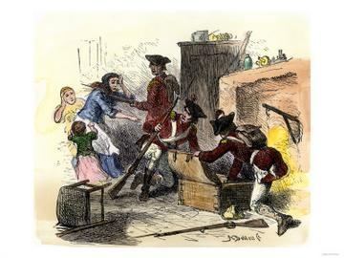
Quartering Act
1774
Part of the Intolerable Acts
Allowed British troops to take residence in any colonial home
Also allowed British troops to claim any colonial property for the British military
Made such an impact, that today this is forbidden by our Bill of Rights

Slide 7
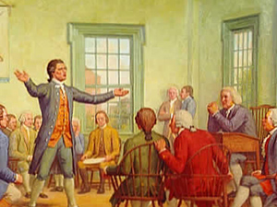
1st Continental Congress
1774
Met in Philadelphia, Pennsylvania
All colonies represented except Georgia
Drew up a declaration of colonial rights stating that colonies had a right to control their own business
Decision: all colonies would boycott British goods and form militias
Also stated that this if things did not improve, they would meet again in a couple of years
Asked King George for membership in Parliament; he refused

Slide 8
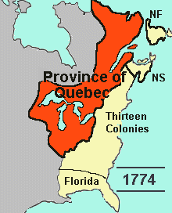
Quebec Act
1774
British attempt to try and control settlers in this region used to French law
Expanded Quebec into the Ohio River Valley and west of the Mississippi River
Many British colonists feared this would give the remaining French too much power and cause future armed conflicts
They also wanted to settle on this territory that now seemed closed off

Slide 9
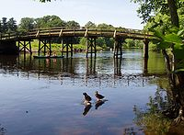
Lexington and Concord
1775
After the 1st Continental Congress, colonial militias had started to stockpile weapons and supplies
Goods became scarce for the British led by General Gage
Gage gave the orders to go to Lexington and Concord and destroy all weapons they could find
Paul Revere and others attempt to alert the colonists of the British movements
Known as the “shot heard ‘round the world”
Colonists forced to retreat at Lexington, but force the British to retreat in Concord

Slide 10
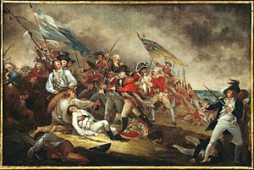
Battle of Bunker Hill
1775
The deadliest match between the British and the colonists
General Gage attack the colonial troops at Breed’s Hill
Colonists eventually forced to retreat but only due to a lack of supplies
British lost over 1,000 men compared to the colonial 450

Slide 11
2nd Continental Congress
Started meeting in May 1775, lasting until July 4th, 1776
Watching the continued escalation of violence, the Congress agreed to name George Washington as commander-in-chief of the colonial military
Started drafting a declaration document
Meanwhile, they attempted peace one last time
Olive Branch Petition
Simply asked for representation in Parliament
King George flatly refused to even open it

Slide 12
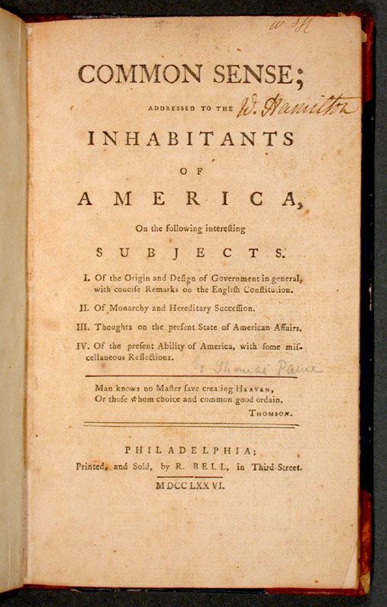
Common Sense
1776
“Without the pen of Thomas Paine, the sword of Washington would have been in vain”- B. Franklin
50 page pamphlet
Argued that time had come for the colonists to claim their destiny and declare independence to protect their future

Slide 13
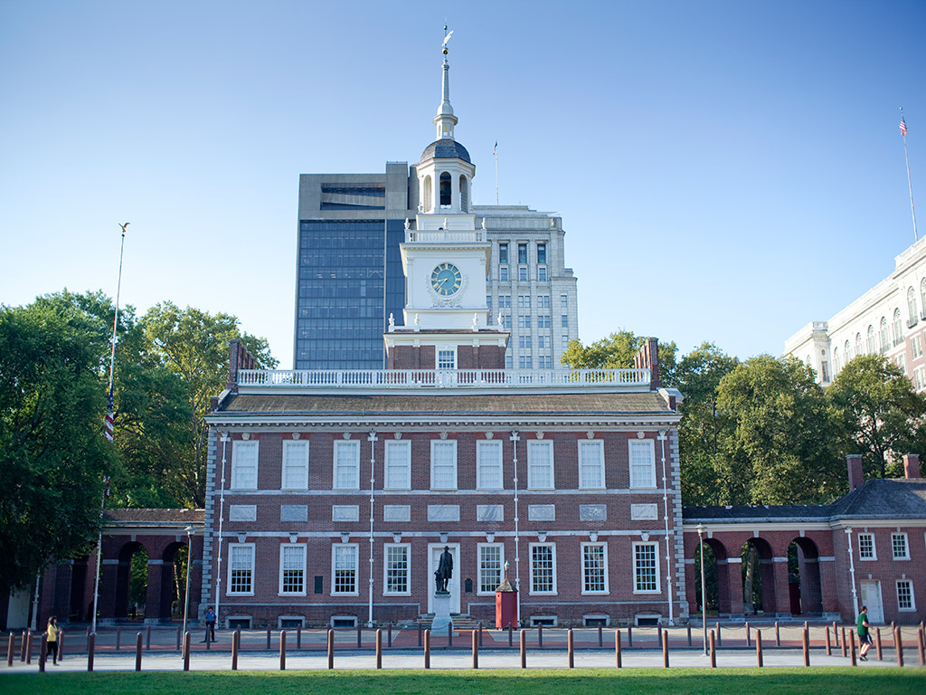
Declaration of Independence
July 4th, 1776- know the date!
Signed by the Second Continental Congress
Thomas Jefferson chosen to write it- uses a lot of the ideas spoken by Richard Henry Lee at the Congress
Uses Locke’s ideas of inalienable rights- Jefferson lists them as: “Life, Liberty, and Pursuit of Happiness”
Address the main grievances of the colonists
Signed in Pennsylvania State House, now known as “Independence Hall”
WAR NOW BEGINS!!!!!

