Slide 1
Reconstruction

Slide 2
Andrew Johnson
Former Senator from TN
Democrat
Only Congressman from a Confederate state who didn’t leave Congress
Supporter of abolition

Slide 3
Reconstruction
Period during which the United States rebuilt POLITICIALLY
Main focus- readmitting Confederate states

Slide 4
Lincoln’s Ideas
South never seceded
Individuals take an oath
10% begins readmission
Rewrite constitutions
Void secession
Abolition

Slide 5
Who was already doing that?
Arkansas
Louisiana
Tennessee

Slide 6
Radical Republicans
Simply the most extreme of all the Republicans
Led by: Thaddeus Stevens and Charles Sumner
Believed Lincoln wasn’t doing enough to punish the South

Slide 7
Radical Republican Response to 10%
Wade-Davis Bill
Congress is actually in charge
51% in state loyal before readmission can begin
“Iron-clad” oath
Promise they had been against the Civil War all along

Slide 8
Lincoln’s Response
He pocket vetoed the bill- so it never goes into effect

Slide 9
13th Amendment
Abolition of slavery

Slide 10
Radical Republicans and Johnson
Upset that it was so similar to Lincoln’s
Refused to admit newly-elected Southern Congressmen

Slide 11
Freedman’s Bureau
Established last month of war
Extended February of 1866
Assisted poor whites and freed slaves by distributing clothing and food
BIGGEST SUCCESS IS WITH SCHOOLS!!!!!!
Johnson vetoes- overriden

Slide 12
Civil Rights Act of 1866
Gave African Americans citizenship
Forbade Black Codes
Johnson vetoed- overridden by Congress

Slide 13
Johnson’s Vetoes
Johnson’s vetoes of the Civil Rights Act and the Freedman’s Bureau alienate moderate Republicans in Congress

Slide 14
14th Amendment
Made “all persons born or naturalized in the United States” citizens
Gave a constitutional basis for the Civil Rights Act

Slide 15
Jim Crow Laws
Segregation laws

Slide 16
Black Codes
ANY law that was just for African Americans and was discriminatory
Different by state and town
Limited freedoms

Slide 17
Elections of 1866
Republicans gained a 2/3 majority in Congress
Allowed them to override ANY Johnson veto (so here comes Congressional takeover of Reconstruction)

Slide 18
Reconstruction Act of 1867
Ratify the 14th Amendment
Give African American men the right to vote
Divided South into military districts with the exception of TN

Slide 19
Impeachment of Johnson
Impeachment means the formal charging of misconduct in office
Impeached because he violated the Tenure of Office Act

Slide 20
Tenure of Office Act
Said Johnson couldn’t fire any Cabinet member without Congress’s approval
He fired Secretary of War: Edwin Stanton
Fell 1 vote short of removal from office

Slide 21
Election of 1868
Ulysses S. Grant becomes the 18th president
New changes: since the African American vote had been so important, Congress ratifies the 15th Amendment

Slide 22
15th Amendment
“no person can be kept from voting because of race, color, or previous condition of servitude.”
South violates with:
Literacy Tests
Poll Taxes
Grandfather Clauses

Slide 23
Physical Conditions of the South
Sherman destroyed over $100 million of property in GA and SC alone
Buildings, railroads, bridges, roads- all had to be replaced
Atlanta, Richmond, and Charleston had largely been abandoned

Slide 24
Economic Conditions in the South
Property values decreased
Every person poorer than they had been at the start of the war
20% of adult white males had died during the war
Massive inflation

Slide 25
Three groups of Republican voters in the South
Carpetbaggers
Scalawags
Former slaves
Largest group of Republican voters in the South

Slide 26
Carpetbaggers
Northerners who moved south in the years after Reconstruction
Looking to take advantage of economic opportunities available
Name refers to their luggage
Not trusted by southerners

Slide 27
Scalawags
Native-born southerners who became Republicans
Name means “scrawny cattle”
Considered traitors to many Southerners

Slide 28
Political Differences within Republican Party
Many scalawags didn’t support the Republican commitment to Civil Rights and Suffrage
Many former slaves couldn’t voice their opinions due to restrictions on the 15th Amendment

Slide 29
Adjusting to freedom
Travel was common
Many changed their names
Finding work/shelter was a primary concern and limited many

Slide 30
Families
Freedman’s Bureau worked to reunite families
Most families were never reunited
Getting to build and keep families was an important part of being free

Slide 31
Education
Approximately 80% of African Americans illiterate in 1870
Education was a priority for many
Shaw University was the first college established for African Americans

Slide 32
Churches and Volunteer Groups
Most African American churches were Baptist or Methodist
Ministers became community leaders (think MLK)
Also established fire stations, political organizations, drama clubs, etc.

Slide 33
Politics
15th Amendment gave African American men the right to vote
Hiram Revels: first African American to serve in Congress (Senator from Mississippi)
Joseph Rainey: first African American to serve in the House of Representations (SC)

Slide 34
Laws Against Segregation
Began as laws to desegregate public transportation
Even laws that are passed are often violated
African Americans also focused more on building up the black community rather than total integration

Slide 35
Restriction of Rights: “40 acres and a mule”
Initially promised by Sherman at the end of the Civil War
Taken away by Johnson in 1865
Redistribution of land never happened- some African Americans did end up finding ways to own land (1 in 12 in Mississippi)

Slide 36
Restriction of Rights: Plantations
Plantations had fallen apart during the Civil War
Some southerners and northerners attempted to bring them back
Never the same again due to: labor shortages and fall of cotton

Slide 37
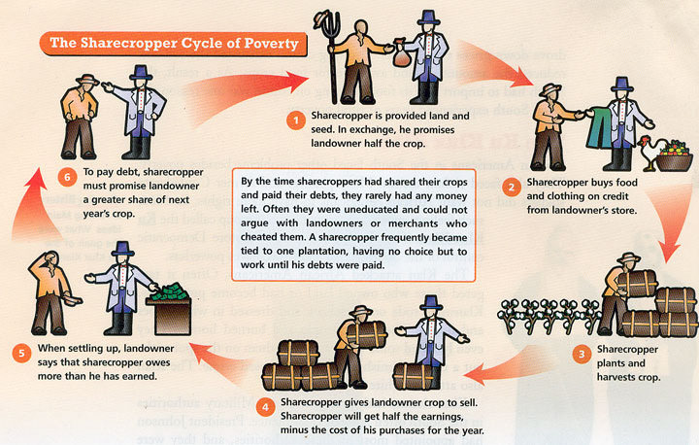
Restriction of Rights: Sharecropping

Slide 38
Restriction of Rights: Sharecropping
Known as “informal slavery”
Goal for workers: to make enough money to buy own land
Goal for landowners: to keep workers in debt to “own” them

Slide 39
Restriction of Rights: Sharecropping
Workers would sign a contract to work in exchange for part of the crop
They would borrow money for food, clothing, and shelter from the land owner
They never made enough to leave the land

Slide 40
Restriction of Rights: Tenant Farming
Step-up from sharecropping
Rented land instead of serving as a farm hand
Still not completely autonomous because they didn’t own the land

Slide 41
What happened to cotton?
Demand for southern cotton decreased as other countries increased their cotton production

Slide 42
Southern Response
Instead of diversifying their crops, Southerners simply grew more cotton to try and make up the difference
They created a surplus driving the price of cotton down even further

Slide 43
What was the KKK?
It started as a social club for Confederates
As it got more popular, it turned into a white supremacy group

Slide 44
What sorts of things did they do?
Main goal: Keep African Americans from voting!!!!
Burned crosses, tarred and feathered, destroyed property, etc.
Went after both African Americans and whites who attempted to help them

Slide 45
What things did the KKK do to control elections?
Intimidated black voters
Threatened Republican politicians with death
Killed John Stephens (NC state senator)

Slide 46
What was passed in hopes of controlling the KKK?
The Enforcement Acts were passed giving extra power to the national government in restoring order in the South (including fighting the KKK)
Grant didn’t use them as strongly as he could by the end of his presidency…still leaving some power for the KKK

Slide 47
Shifts in Political Power
Power shifted back to Democrats in the South through:
Amnesty Act: allowed 150,000 former Confederates to vote
Expiration of the Freedman’s Bureau

Slide 48
Grant as President
Used the Spoils System
Led to corruption…and lots of it!

Slide 49
Grant Scandals
Credit Mobilier: Company reported inflated expenses and pocketed the extra
Whiskey Ring: Companies paid members of Grant’s cabinet bribes to avoid paying the Whiskey Excise

Slide 50
Panic of 1873
Causes:
Overexpansion of companies (leading to debt)
Jay Cooke’s investment in railroads that failed leading to a collapse in the banking industry
Collapse of the stock market

Slide 51
Panic of 1873
Effects:
5 year depression
3 million Americans lost their jobs
Republican party was blamed and lost support…leading to Democrats taking over Congress

Slide 52
Northern Support Fades
People were tired of hearing about the crimes of the South
Cared more about:
Grant’s corruption scandals
Panic of 1873
Leaders of the Radicals are dead

Slide 53
Southern “Redemption”
The return of Democrats in power in throughout the South
Solidified with the end of Reconstruction

Slide 54
Election of 1876
Candidates:
Republican: Hayes
Democrat: Tilden
Results:
Tilden won the popular vote
Tilden won more Electoral votes…but not enough to be declared the winner

Slide 55
Compromise of 1877
Called the Hayes-Tilden Compromise
Southern Congressmen agreed to name Hayes president IF:
Named a Southern Democrat to his cabinet
Removed troops from South
Paid for railroad from TX to West Coast
Official end of Reconstruction

Slide 56
Home Rule
Ability of the South to run their own state governments without federal intervention
Finally occurred in 1877 (first time since 1865)

Slide 57
Successes of Reconstruction
13th, 14th, 15th Amendments
Provide the backbone of the later Civil Rights Movement
All states rejoin the Union
Public Schools established for everyone

Slide 58
Failures of Reconstruction
Sharecropping sets up “informal” slavery in the U.S.
Massive racism overtakes the South
Newly acquired rights for blacks are constantly violated
South remains the poorest section of the country for years

